Slide 1



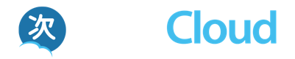
Standardization in Apereo and IMS to Enable Next Generation Digital Learning Ecosystem (NGDLE)
Dr. Charles Severance
University of Michigan School of Information
www.tsugi.org www.apereo.org www.tsugicloud.org
https://www.slideshare.net/csev

Slide 2
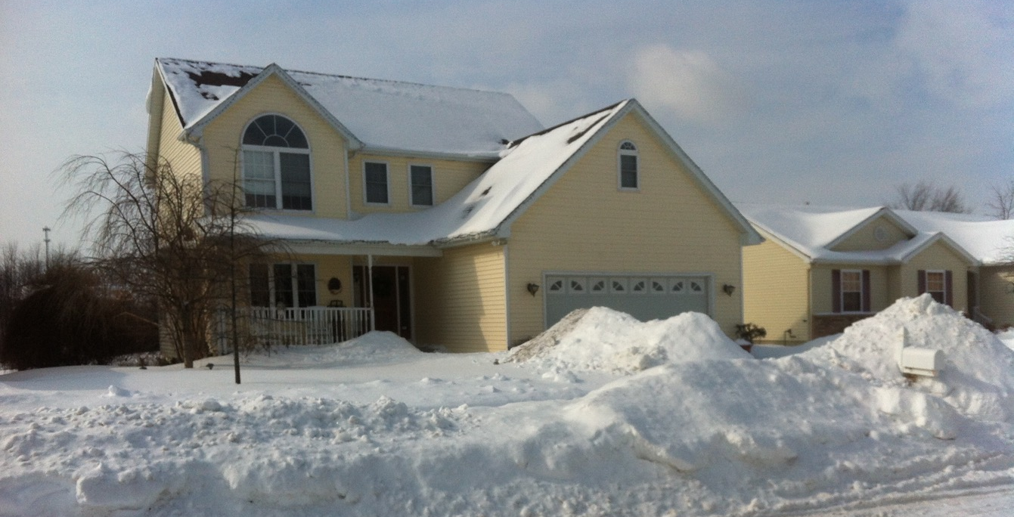
Notes:
A few weeks ago we had over a foot of snow on the ground. But now it is warming up and winter is ending….

Slide 3
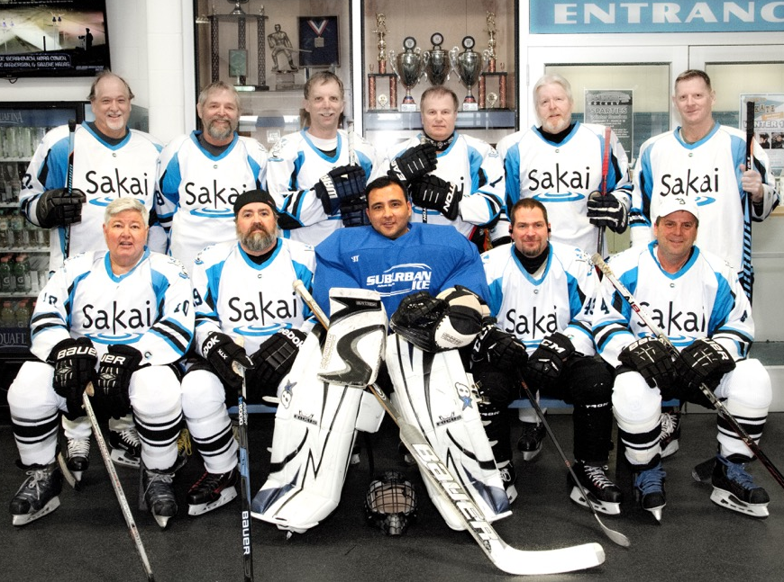
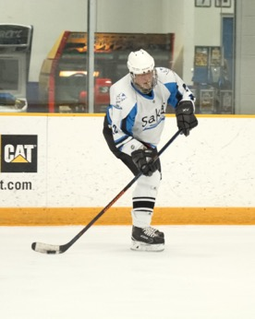
https://goo.gl/7i6GwA
Notes:
towards the end of winter in the United States it is hockey playoff time including the Sakai/Apereo Hockey Team

Slide 4
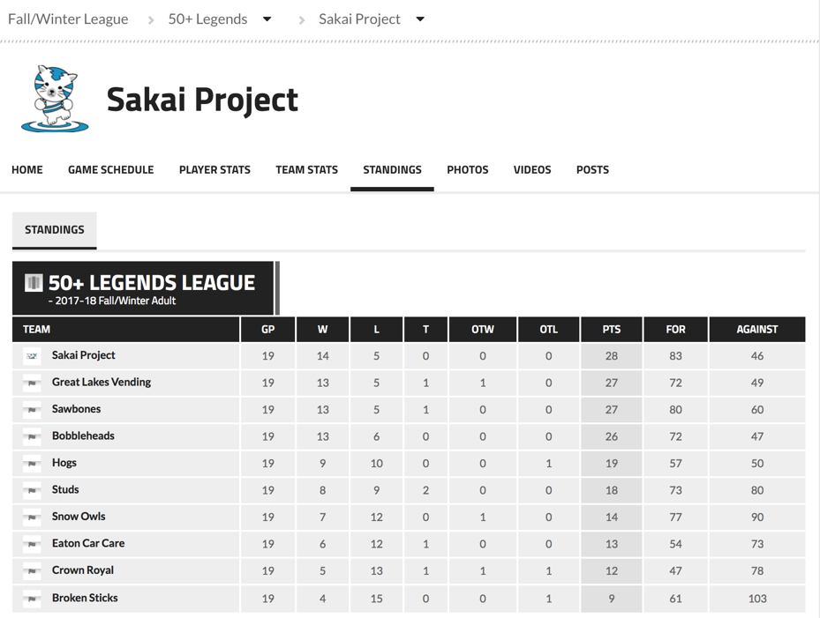
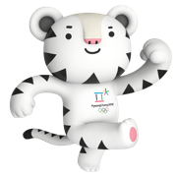
https://goo.gl/7i6GwA
Notes:
Who happen to be in first place in the 50 and over league…

Slide 5

Notes:
Many things happen as winter transitions to spring

Slide 6
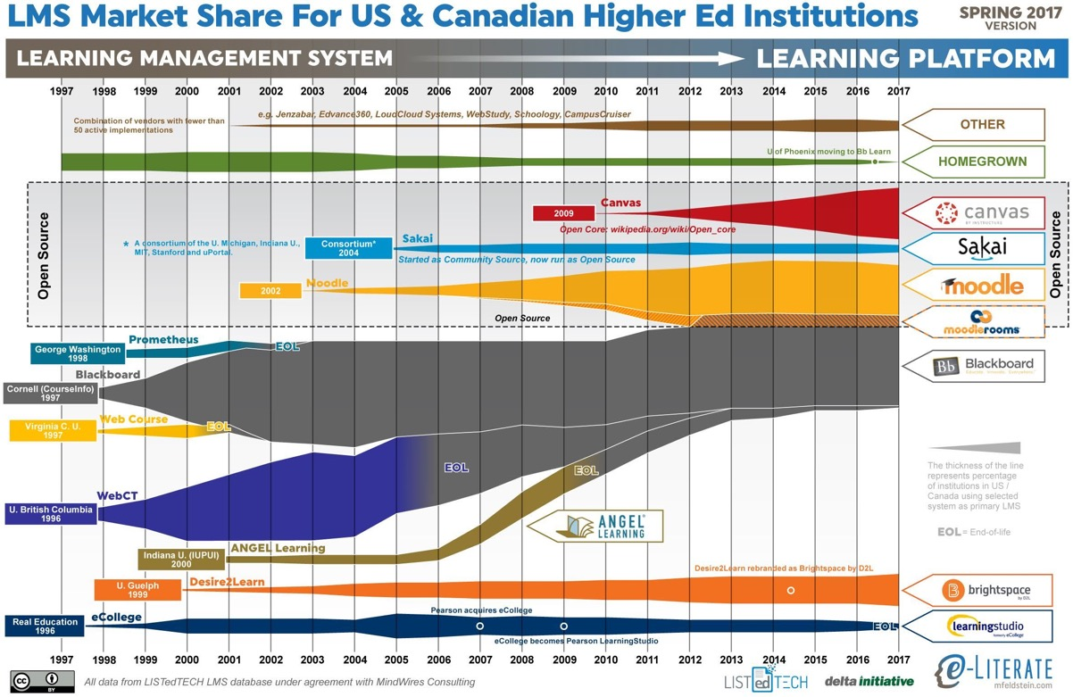
Notes:
Each Spring the people at eLiterate publish the next version of the "Learning Management System North America Market share" – also known as the "LMS Squid Diagram". I have been building Learning systems since 1997 – so this represents the past 20 years of my life. I would make two observations about this diagram. (a) over time once a company reaches 60% of the market they get disrupted, (b) since 2012 the diagram keeps predicting that there will be a major disruption to the whole marketplace "very soon now".

Slide 7


Innovation
Independence
One Universal
LMS
Searching for the Best LMS
1994
1997
2018
2024
Notes:
Before 1997, every school and at times every faculty member has their own learning "web site". He had no idea what the features of a general purpose LMS should be. The initial round of LMS companies took code from a university and commercialized it. Even Sakai was founded to combine the efforts of four universities to make a single product we could all use. The overall trend was moving from a lot of different systems with specialized features to fewer systems with more general features. In 2017, features are no longer the differentiator between LMS systems – it is usability and integration capability. I think by 2025 there will be just one relevant LMS in the marketplace. Does anyone recognize the logo?

Slide 8
Innovation
Independence
One Universal
LMS
Searching for the Best LMS
Google
Classroom
1994
1997
2018
2024
Notes:
Remember Word Processors? How many people 14-18 use Word regularly? Time is on Google's side. Google Docs is not as flexible as LaTeX. Google Docs does not support business use cases as well as Microsoft Word. No one cares. Everyone compromises a little bit and we have a uniform solution. No one loves it but no one really hates it either – and once it owns the market – it never changes.

Slide 9
Innovation
Independence
One Universal
LMS
Searching for the Best LMS
Innovation?
Google
Classroom
1994
1997
2018
2024
Notes:
Have you ever made a feature request for Google Docs? Have you ever been to a Google Doc's conference where users prioritize new features? Thirty years after we build the first of many LMS's, we have built the last LMS. But teaching is always improving. How can we innovate when our LMS vendor refuses to make even the simplest change because a product with 100% market share is by definition perfect.

Slide 10
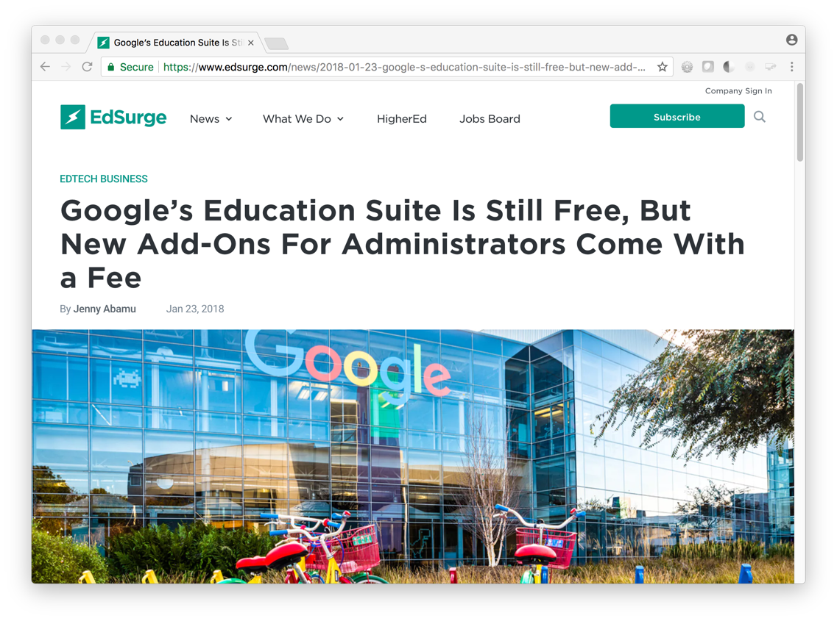
Notes:
I heard that the LMS marketplace is at least worth $6B – that is interesting to Google – especially since we will accept an LMS with a very low level of built-in functionality.

Slide 11
Innovation
Independence
App Store
Ecosystem
Many -> Few
1994
1997
2018
2025
Notes:
Bring back innovation by surrounding the one true LMS with a rich ecosystem of beautiful and flexible of learning applications that plug into that LMS. It would even be better if that app store ecosystem worked with the current generation LMS systems to allow for an orderly transition from a market with choices to a market with no choices.

Slide 12
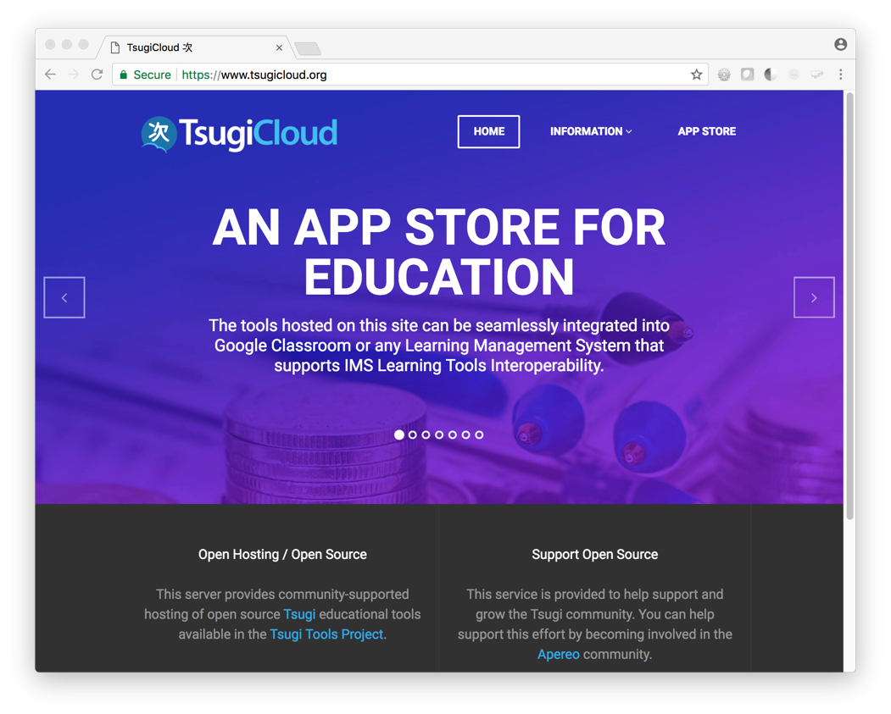
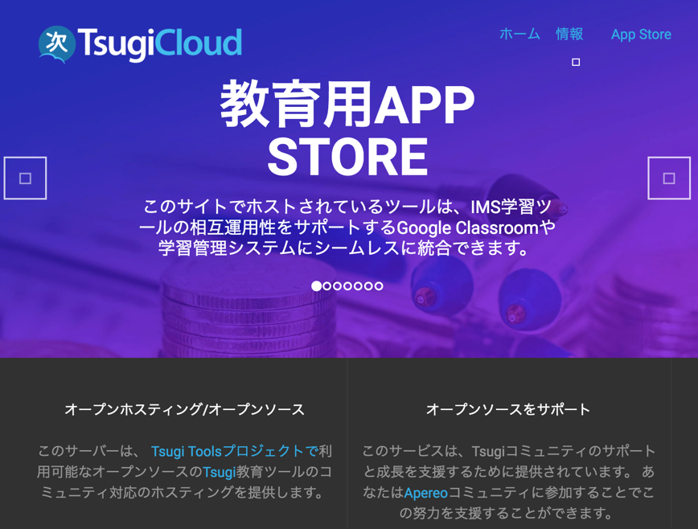
Peeking ahead….
Notes:
Refer to the pamphlet.

Slide 13
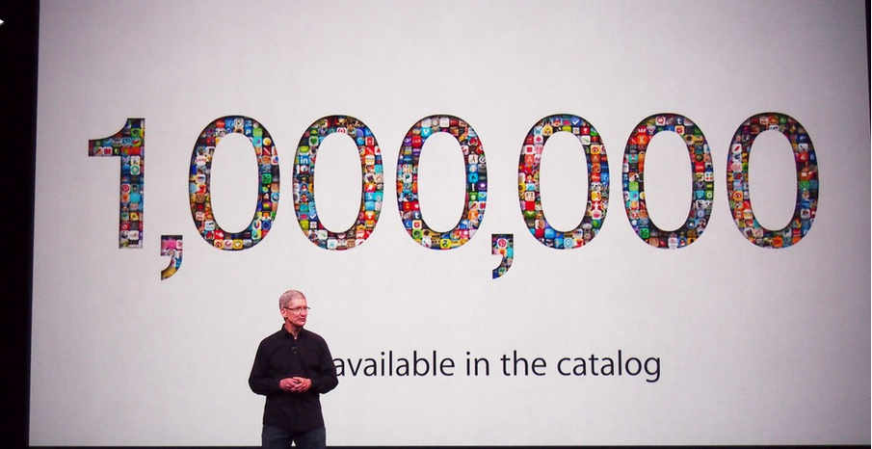
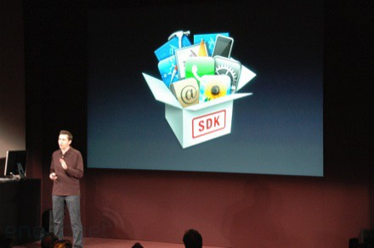
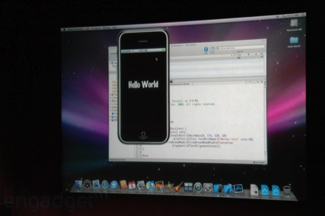
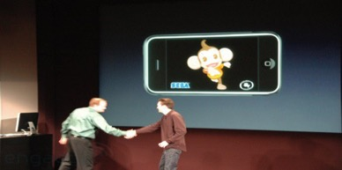
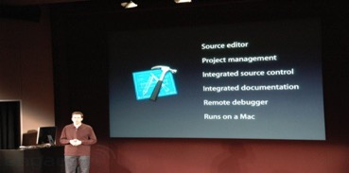
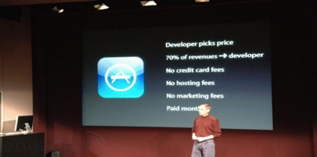
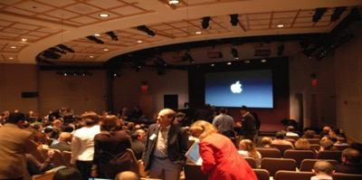
March 6, 2008 iPhone SDK Press Conference
Notes:
We need to build an ecosystem with lots of developers that can work independently and market their tools to customers without having to build a customer relationship with each customer. And conversely the purchasers don't want to have a million separate contracts with the developers of small tools. Sounds like an App Store.

Slide 14

The Standards Are Ready
Notes:
It turns out things are lining up.

Slide 15
DEEP LINKING®
CC®
LTI®
IMS DEEP LINKING® FILLS THE GAPS AND MAKES CONNECTIONS BETWEEN IMS LEARNING TOOLS INTEROPERABILITY® AND IMS COMMON CARTRIDGE®.
LTI®, CC®, and Deep Linking® are trademarks of IMS Global Learning Consortium, Inc. (www.imsglobal.org)

Slide 16
DEEP LINKING®
CC®
LTI®
IMS DEEP LINKING® は、IMS LTI®と IMS Common Cartridge®を接続し、ギャップを埋めます。
LTI®, CC®, and Deep Linking® are trademarks of IMS Global Learning Consortium, Inc. (www.imsglobal.org)
Notes:
IMS DEEP LINKING® FILLS THE GAPS AND MAKES CONNECTIONS BETWEEN IMS LEARNING TOOLS INTEROPERABILITY® AND IMS COMMON CARTRIDGE®.

Slide 17
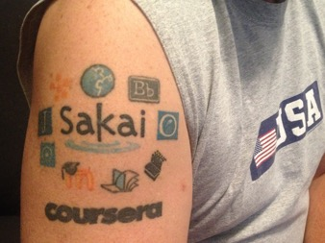

Blackboard
Complete: LTI 1.1, Common Cartridge, Deep Linking
In Progress: Membership and Gradebook
Canvas
Complete: LTI 1.1, Common Cartridge, Deep Linking
In Progress: Membership and Gradebook
Desire2Learn
Complete: LTI 1.1, Common Cartridge, Deep Linking
In Progress: Membership and Gradebook
Sakai
Complete: LTI 1.1, Common Cartridge, Deep Linking
In Progress: Membership and Gradebook
Notes:
IMS Learning Tools Interoperability (which the Sakai Project started in 2004). is what laid the foundation for this market disruption. I have been putting slides like this up for years. There has never been better alignment amongst the major players in terms of support for standards.

Slide 18

Open Source Is Ready

Slide 19

100% Open Ecosystem
Open LMS - Sakai
Open App Store - Tsugi
Open Analytics – OpenLRW / Open LRS
Notes:
Focus - A suite of open source solutions, connected together using industry standards
Sakai - Evolves towards a next-generation LMS
Tsugi – The first cross-platform Education App Store
Build - Analytics solutions across the ecosystem

Slide 20

Sakai Principles
Lightness: today’s 2.9 million lines of code is being intentionally reduced
Usability: including a simple, easy-to-use, globally accessible interface
Choices: in templates, layouts, and tool selection
Interoperability: using our influence to build better integration standards
API coverage: including all services with externally accessible APIs
Cooperation: helping others to implement and use open standards
Analytics: more data, both from the LMS itself and from integrated tools

Slide 21


基本原則
Lightness: 290万行のコードを意図的に削減中
Usability: シンプルで使いやすいユニバーサルにアクセス可能な
インターフェース
Choices: テンプレート、レイアウト、およびツールの選択肢
Interoperability: Sakaiの影響力を利用してより良い統合のための標準規格を開発
API coverage: すべてのサービスに対する外部からアクセス可能なAPI
Cooperation: 人々がオープンスタンダードを実装し使用する支援
Analytics: LMS自体と統合ツールの双方からより多くのデータを取得
Notes:
Lightness: today’s 2.9 million lines of code is being intentionally reduced
Usability: including a simple, easy-to-use, globally accessible interface
Choices: in templates, layouts, and tool selection
Interoperability: using our influence to build better integration standards
API coverage: including all services with externally accessible APIs
Cooperation: helping others to implement and use open standards
Analytics: more data, both from the LMS itself and from integrated tools

Slide 22
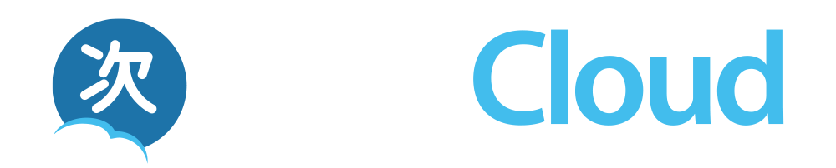
A Standards-Based Educational App Store

Slide 23
March 6, 2008 iPhone SDK Press Conference

Slide 25
Free cloud-hosted Apereo Tsugi tools
IMS Integrations + Google Classroom
A teacher can use it in a single course
Campus IT staff can install in an LMS in all courses
Developers can build and contribute apps (paid)
Commercial cloud hosting is coming soon…

Slide 26
クラウドベースの Apereo Tsugi ツール（無料）
IMS 標準規格による Google Classroom との統合
教師は自分のコース内だけでも使用可能
キャンパスITスタッフは、すべてのコースで使えるよう，大学の LMSにインストール可能
デベロッパーはアプリを開発して貢献（有料）
商用クラウドホスティングサービスもまもなく 利用可能...
Notes:
Free cloud-hosted Apereo Tsugi tools
IMS Integrations + Google Classroom
A teacher can use it in a single course
Campus IT staff can install in an LMS in all courses
Developers can build and contribute apps (paid)
Commercial cloud hosting is coming soon…

Slide 27
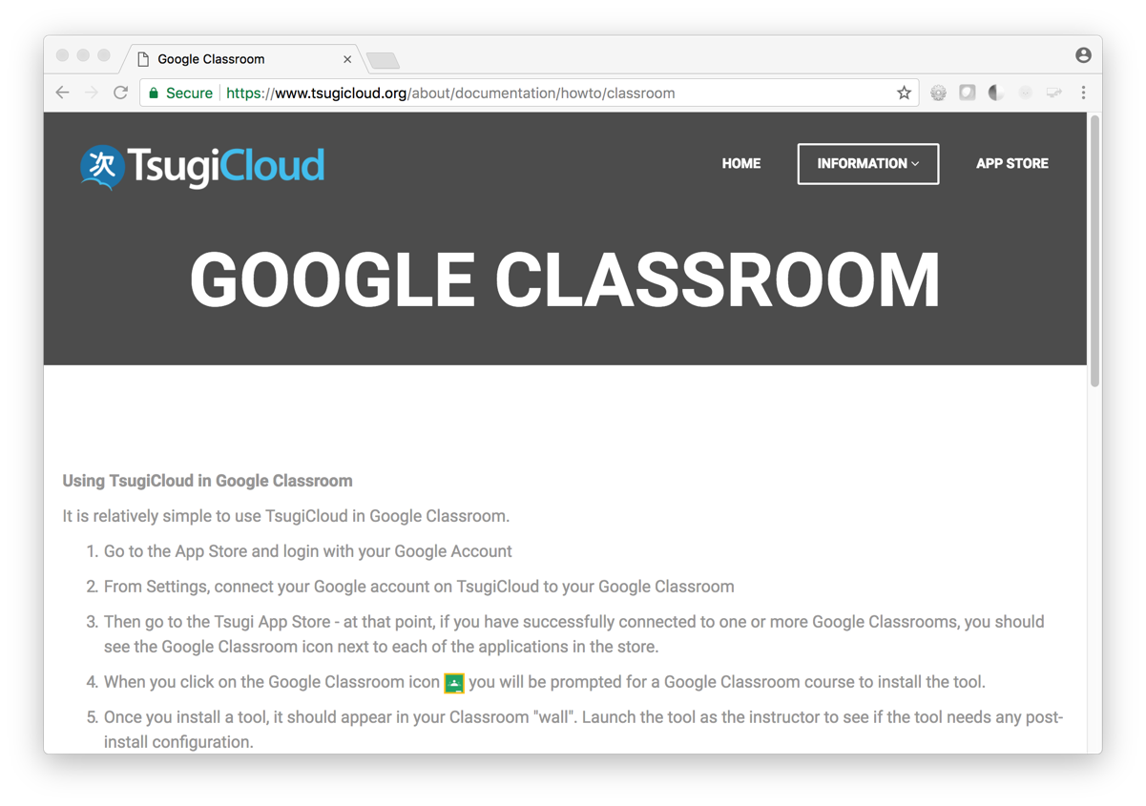
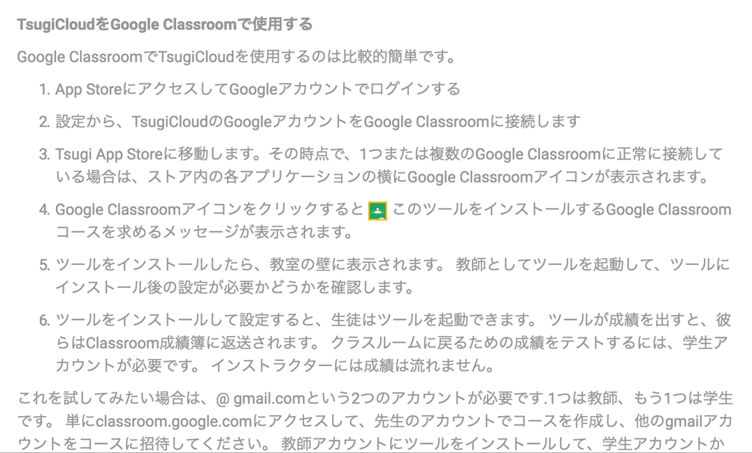

Slide 28
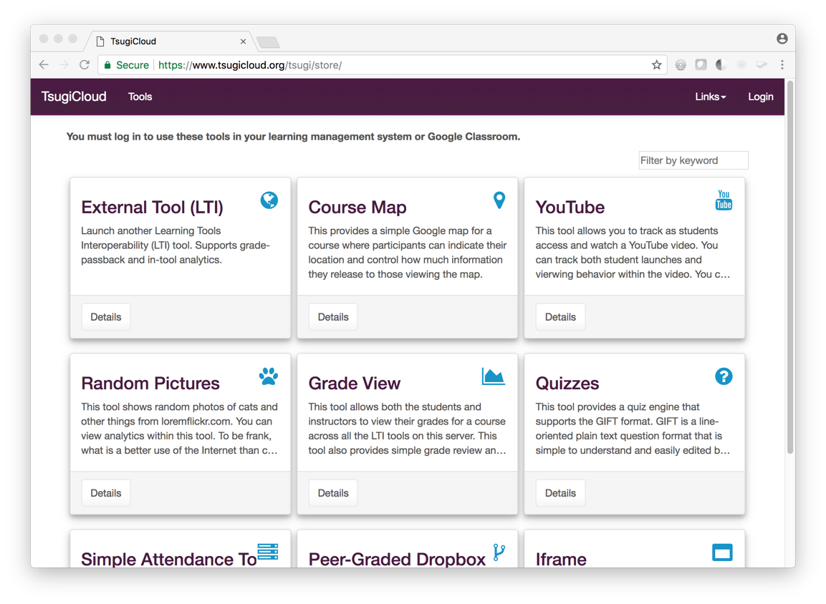
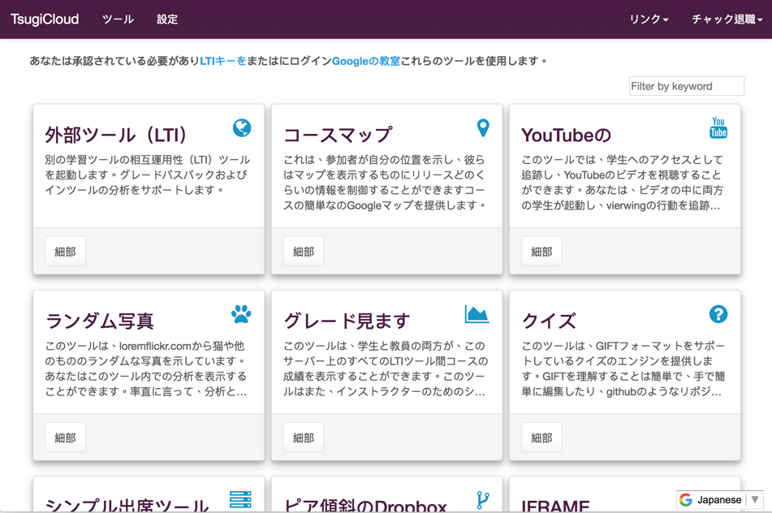

Slide 29
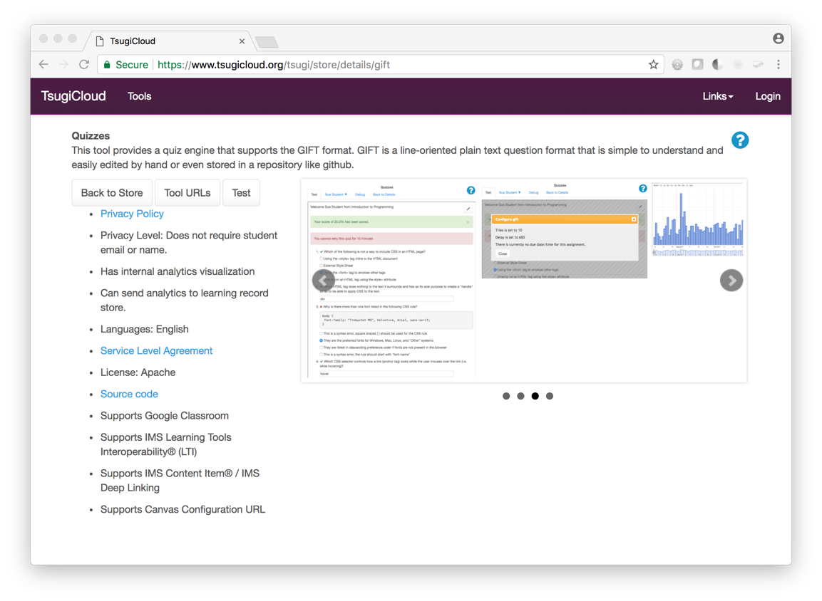
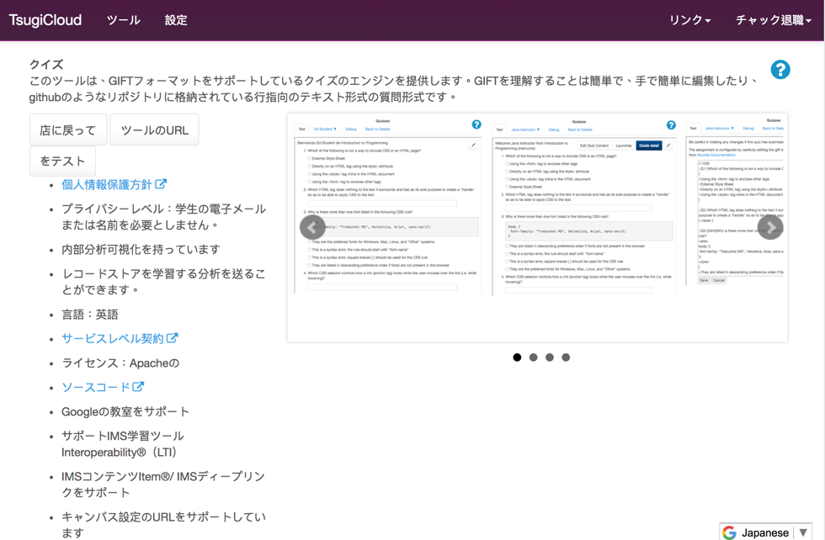

Slide 30
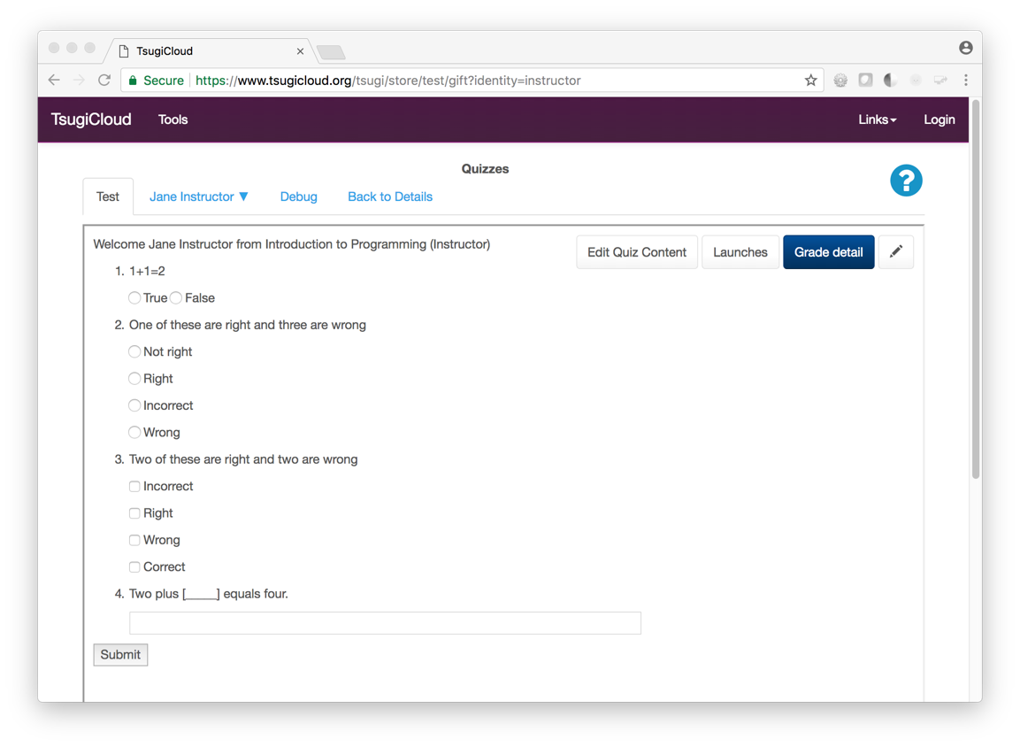
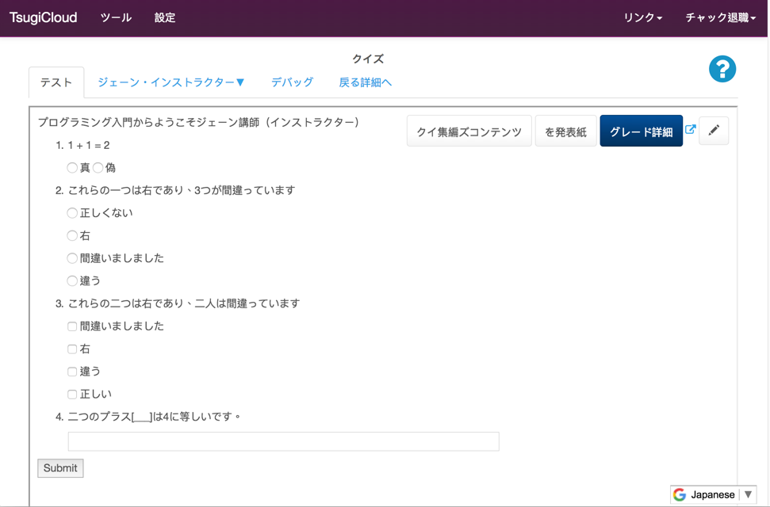

Slide 31

Amazon Architecture
Beta
cloud-01
Aurora
Database
Cloudflare
CDN
Amazon
Load Balancer
cloud-02
Elastic File
System (EFS)
…
DynamoDB
TsugiCloud's Amazon Setup is Open Source

Slide 32

Building Tsugi Learning Apps

Slide 33
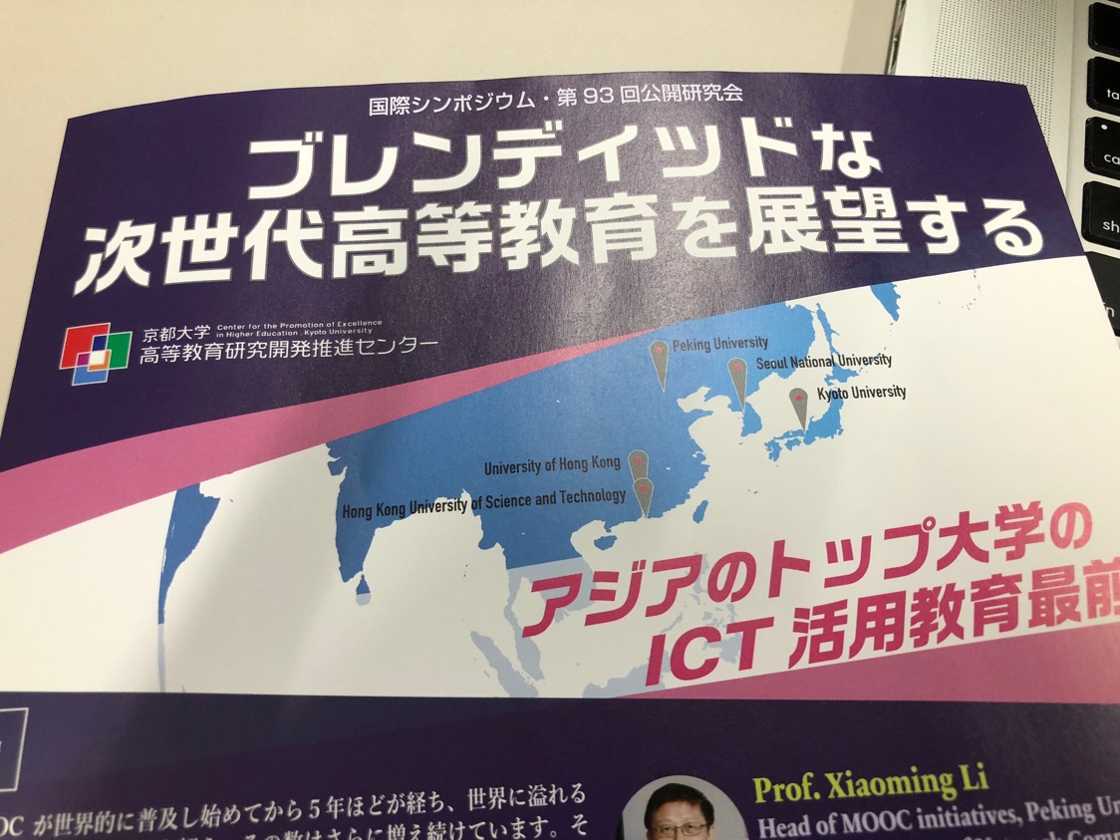

Slide 34
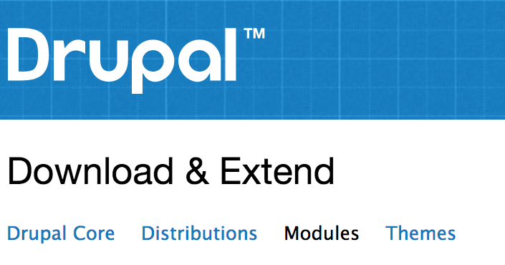

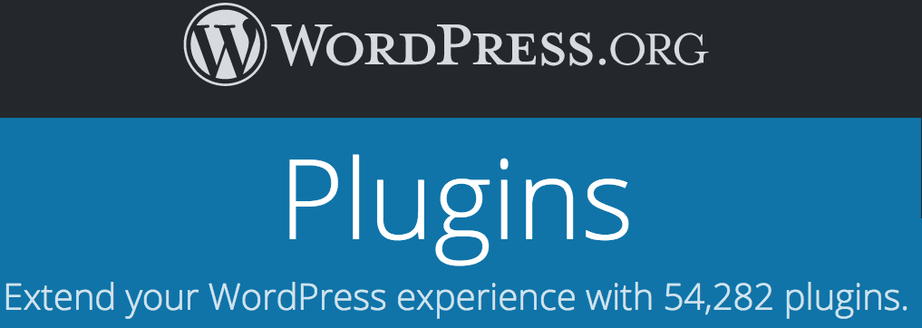


Slide 35
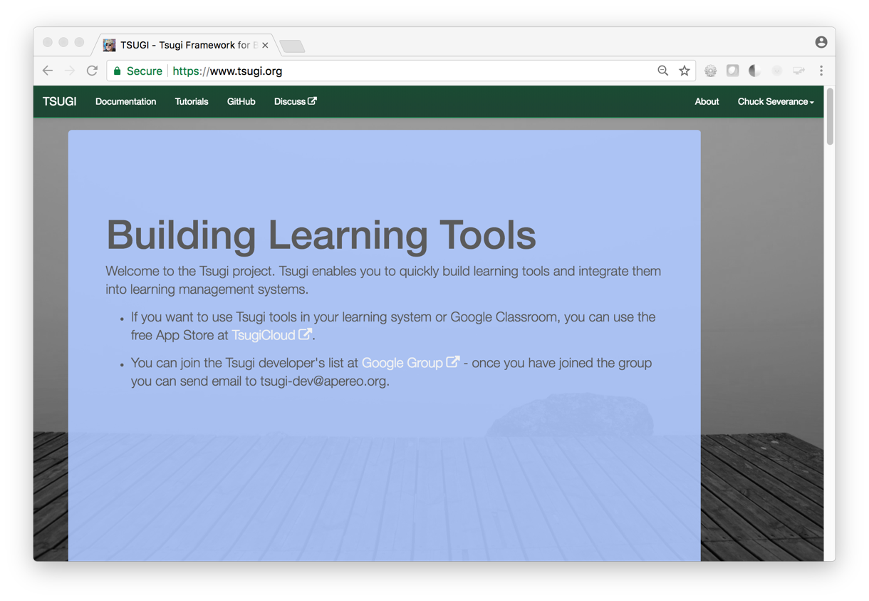
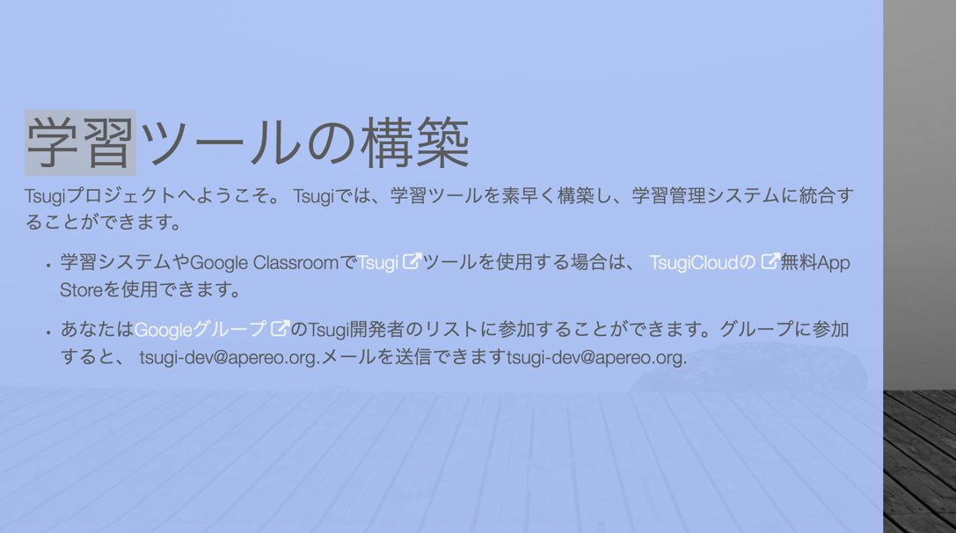

Slide 36
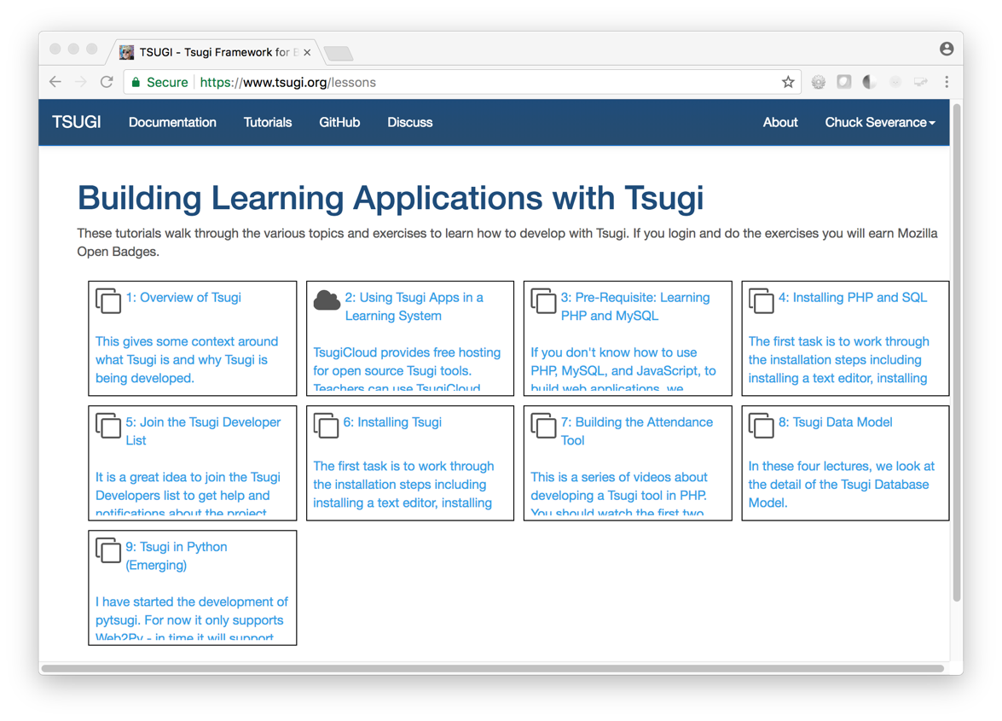
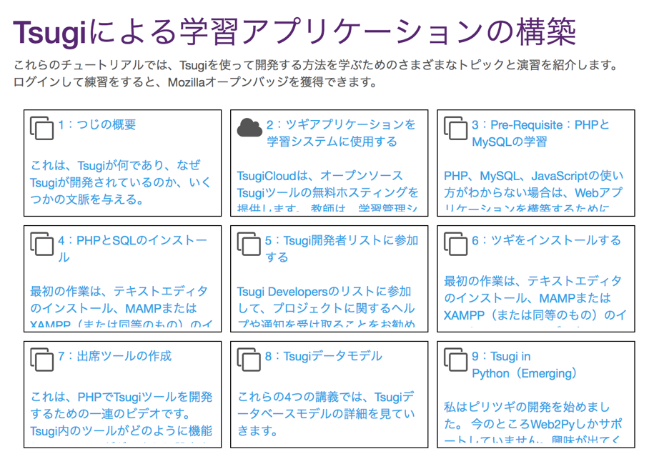

Slide 37
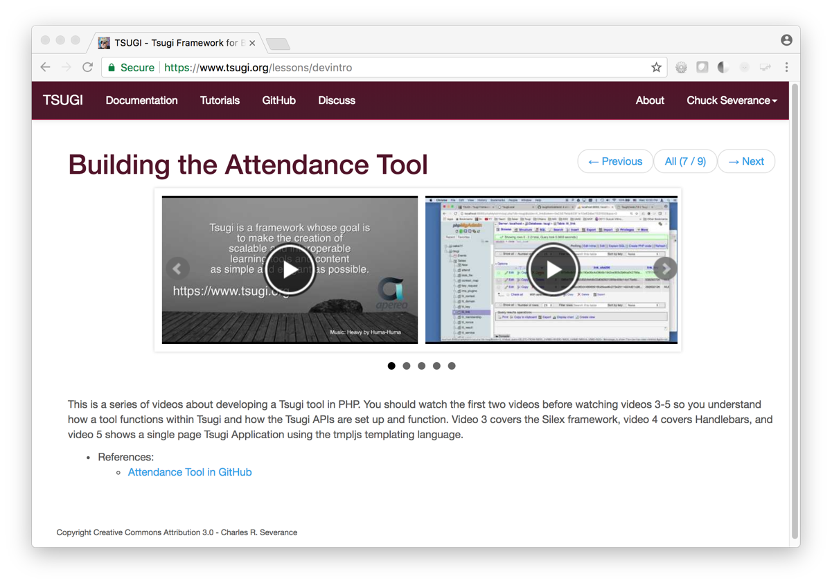
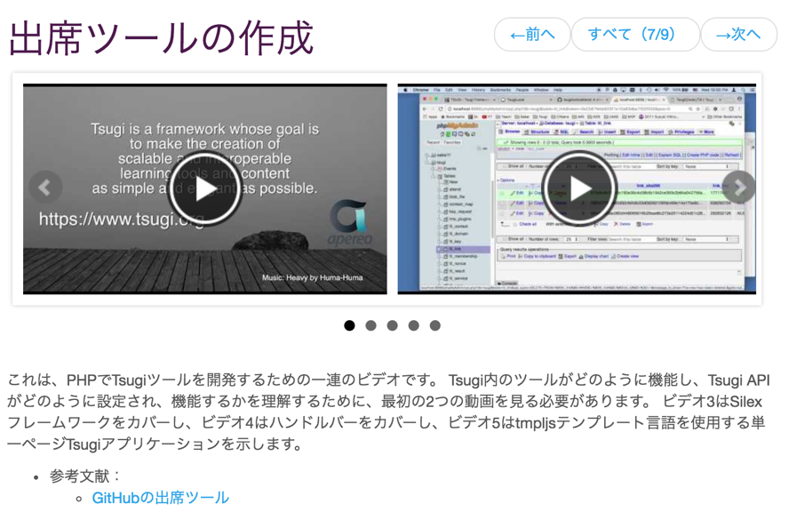

Slide 38
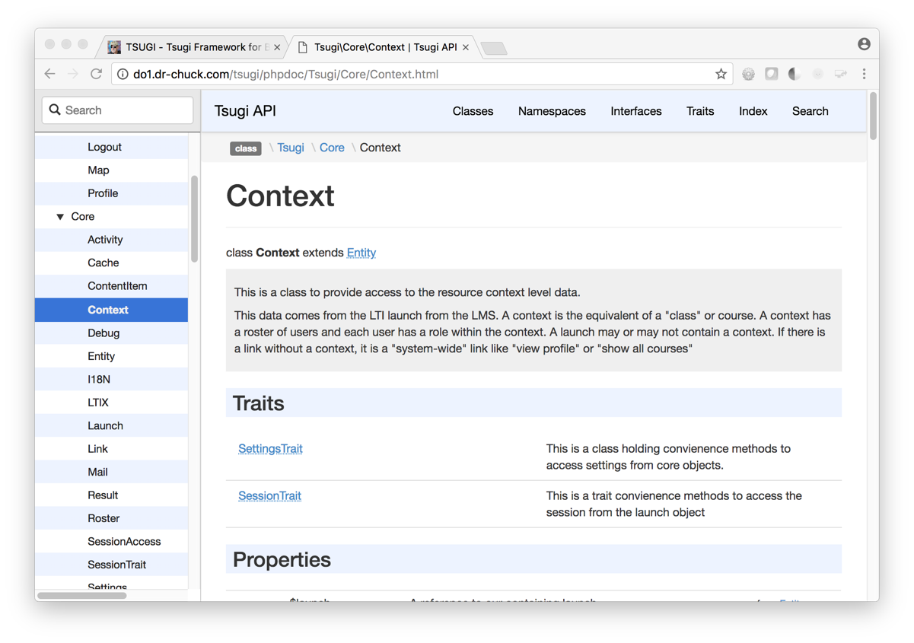
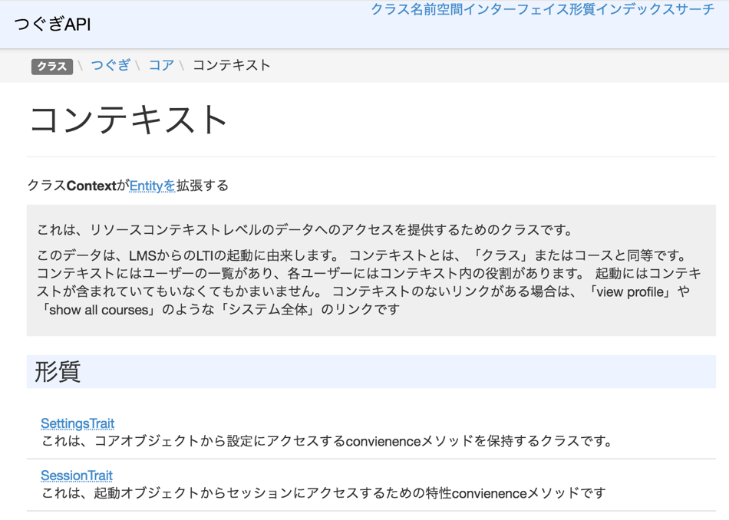

Slide 39
Tsugi APIs
Tsugi App
Adapted App
Any App
UI/UX APIs
Look / Feel
UI Widgets
Opinionated APIs
Convention / Database Model / Session
Easy for App Developer to Use
Utility APIs
Implement Standards
Portable / Resuable outside Tsugi

Slide 40
Tsugi Standards Support
IMS Learning Tools Interoperability 1.0, 1.1, 2.0, 2.1 (draft)
IMS Deep Linking
IMS Common Cartridge
IMS Caliper (limited) and xAPI (limited)
Google Classroom OAuth 2.0 (Proprietary)

Slide 41





Active in Tsugi
Notes:
Duke

Slide 42

Any Questions? www.tsugi.org www.tsugicloud.org

Slide 43
Demo (time permitting)

Slide 44
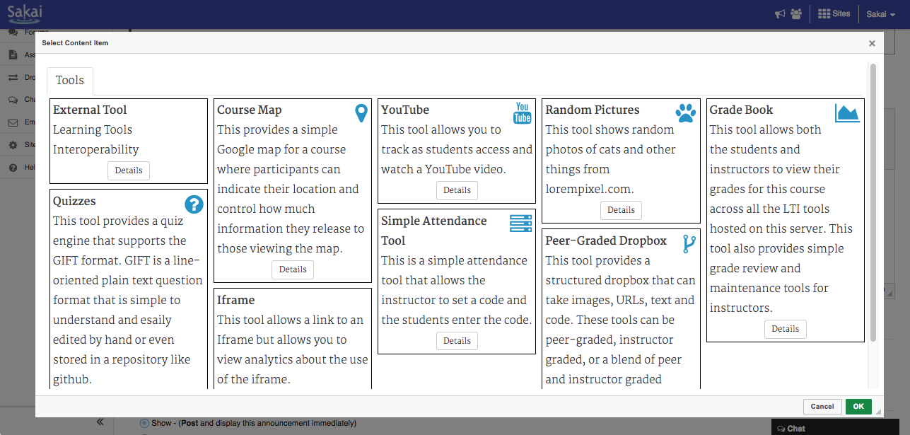

Slide 45
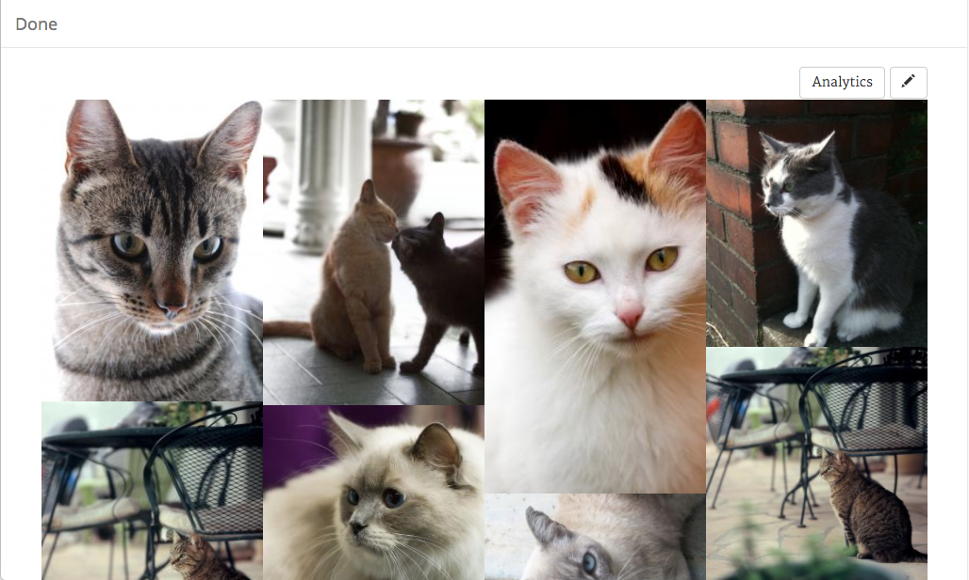

Slide 46
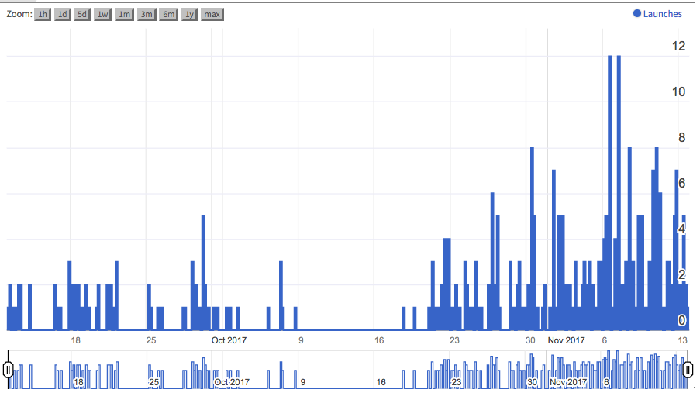

Slide 47
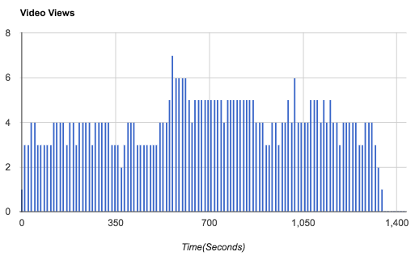

Slide 48
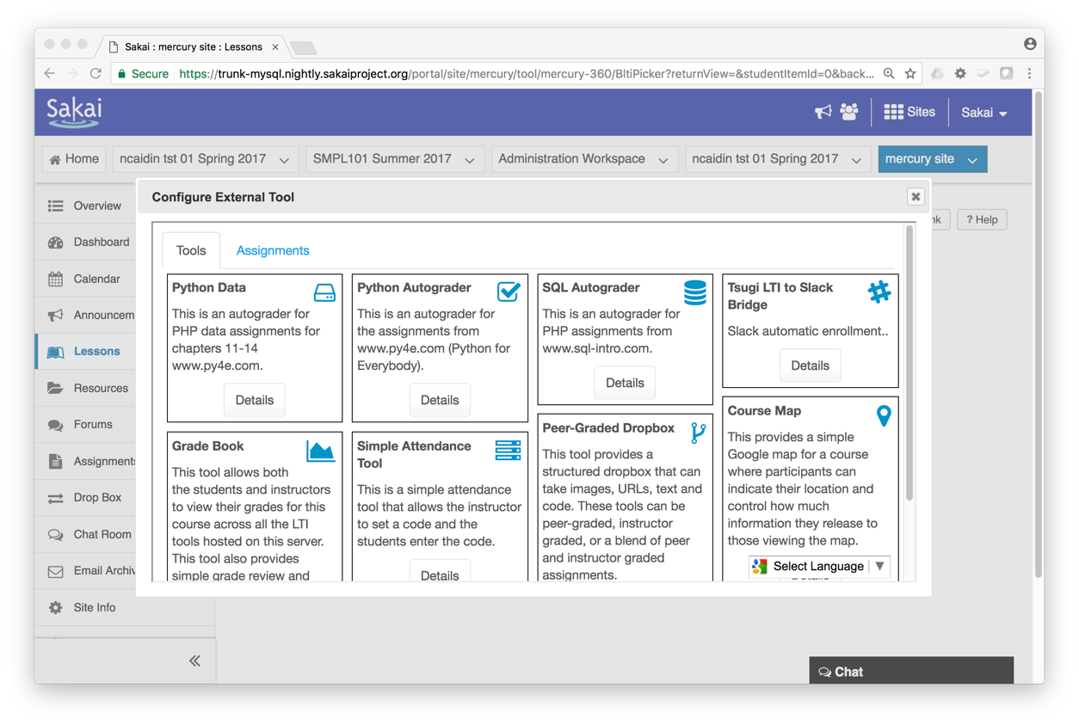

Slide 49
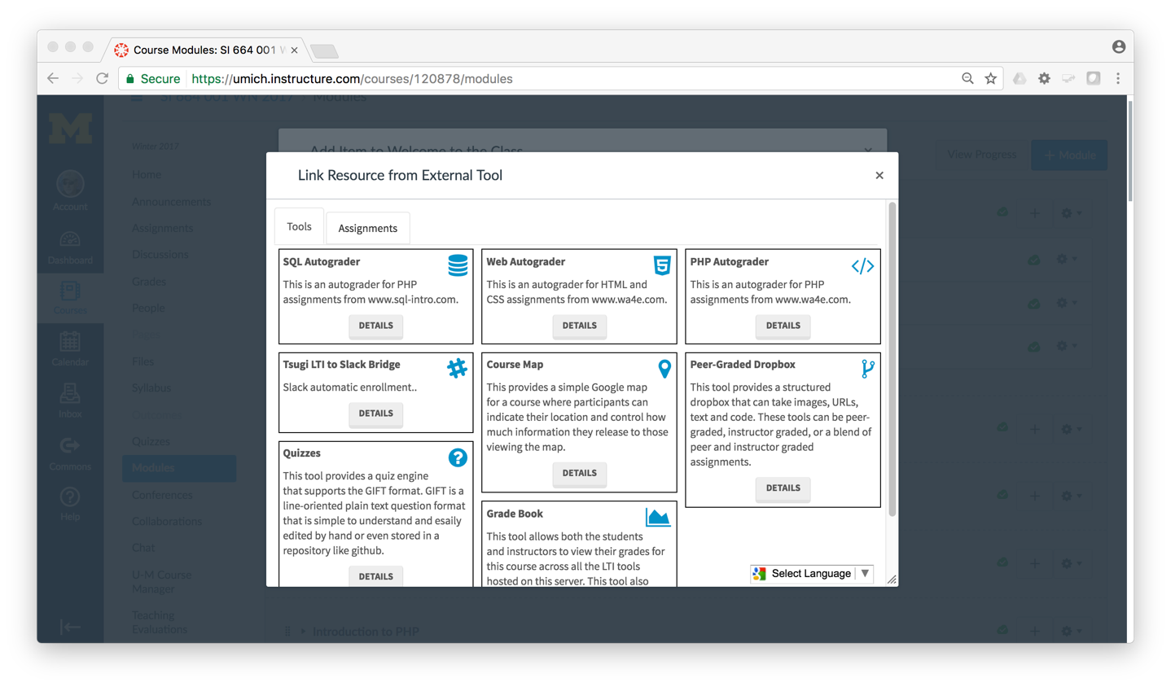

Slide 50
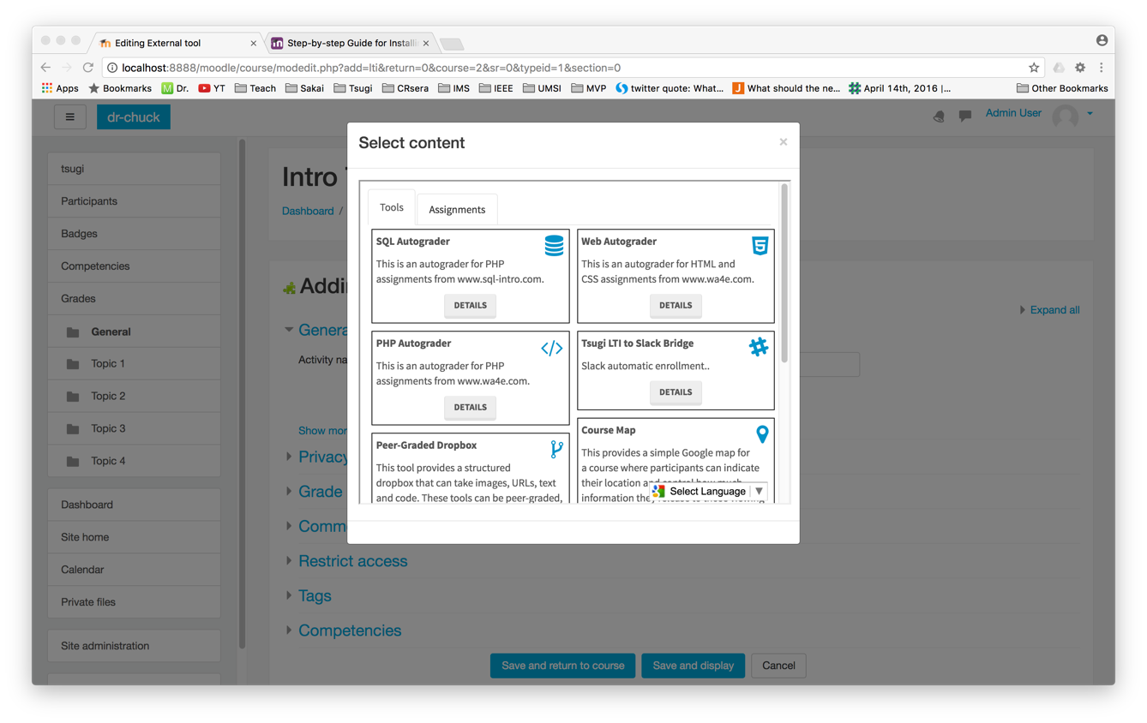

Slide 51
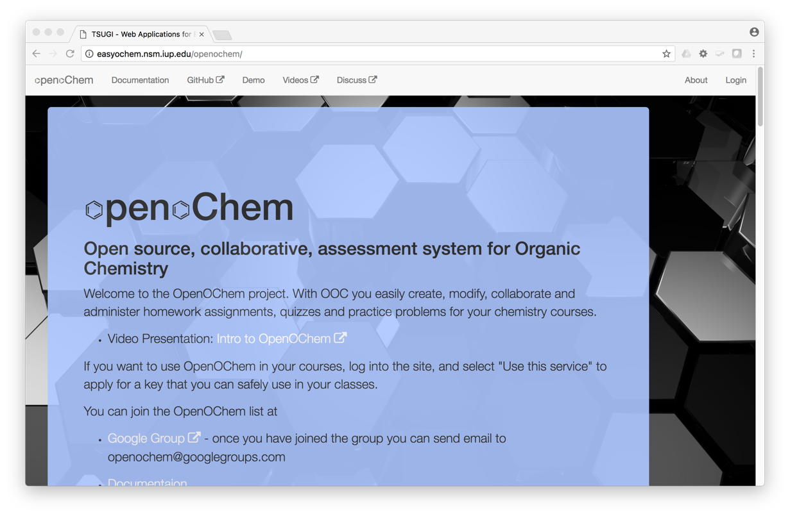
Carl LeBlond, Indiana University of Pennsylvania

Slide 52
Topics
Educational App Store
API Libraries
"Lego Blocks"
Interoperability
New tools that *teach*
EdTech startups made easy
Training / Documentation
Enrich Open Educational Content
Seamless Content Integration and Reuse (LOR)
Stand-Alone MOOC platform
LMS based on Tsugi technology
koseu.org (코스)

